Slide 1
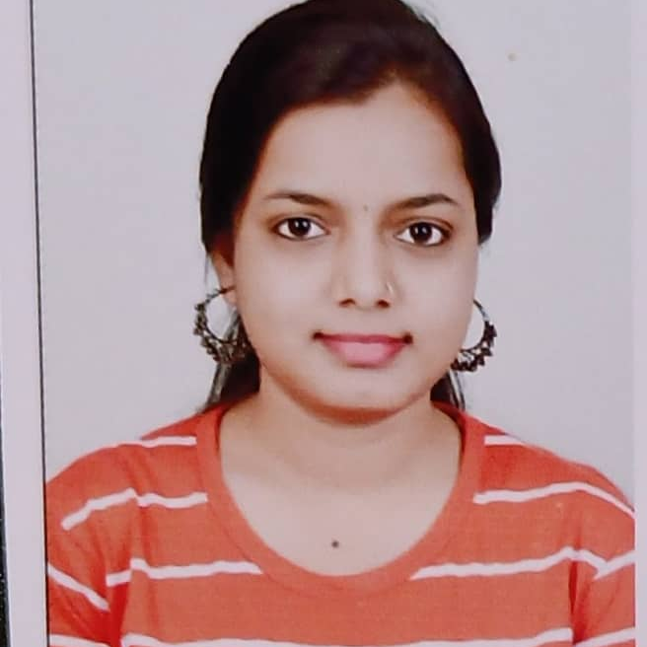


Chaitali Lakshman Chaudhari
Analyst/Software Engineer
Master of Computer Science :
2015 - 2020
Skills
OutSystems
Java 8/ J2EE
Spring Boot, MVC
Spring Security
JPA CRUD
Bootstrap
MERN Stack
Angular
NodeJS
MongoDB
Database
SQL database – MySQL
No SQL database – MongoDB
Web Technologies
HTML5 & CSS3
Javascript
Typescript & ES6
AddOns
Github
Maven
Postman
Additional Details
Communication Skills
Team management
Pune
chaitali.lakshman-chaudhari@capgemini.com
+91 9028715861
A4
Software Engineer who is Strong in design and integration with intuitive problem-solving skills. Passionate about implementing and launching new projects.
Hands on experience on Traditional web development applications of Outsystems.
Hands on experience in creating microservices with Spring boot, Spring Security, Spring cloud API Gateway, Eureka Server, Post Man, Swagger API
Experience in creating documentation with Java docs and swagger and in Unit testing using Junit and Mockito.
1. Deals and Coupons Management Application
Completed end to end case study of Deals and Coupons Application along with JWT authentication, Swagger. Material-UI and Bootstrap used for user interface.
2. Programmers Forum
Programmers forum is an online blogging service, where most of the blogging functions are automated and provided by the blogging service.
Backend (MongoDB), Midware (Spring Boot) and Frontend (Angular) at Capgemini Degreed Platform
Learned and recompiled all concepts of the backend, midware and frontend to polish my skills to work on real –time projects.
FULL STACK DEVELOPER

